Slide 1
MODULAR-ADHERENT INSULIN PUMP SYSTEM
Group 5
Abhiramalakshmi Senthil Kumar, Dhruv Tyagi
Supreeth Sai Krishna, Yolander Adjei

Slide 2
OUTLINE
BACKGROUND WITH STATISTICS
MARKET VALUE
CURRENT TECHNOLOGIES
QFD
DESIGN CONSIDERATIONS
PROTOTYPING FLAWS, PRINTING TRIALS)
MATERIALS & MANUFACTURING
FUTURE CONSIDERATIONS
Presentation Part One Subtitle

Slide 3
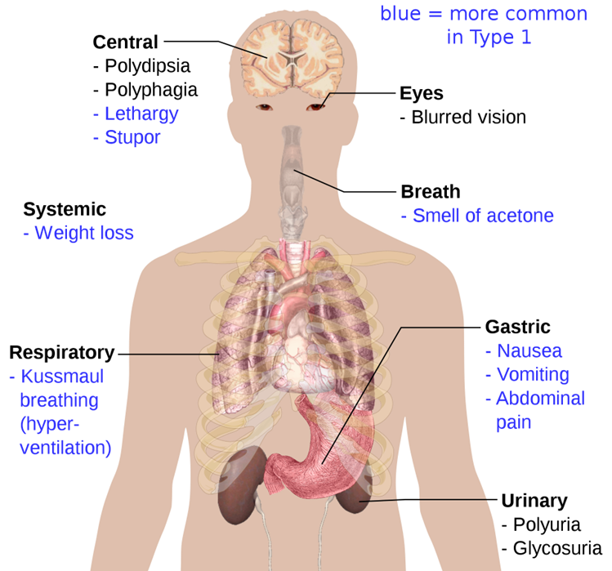
DIABETES
Diabetes is a chronic metabolic disorder marked by high blood glucose levels due to insufficient insulin production, resistance to insulin, or a mix of both. This results in complications affecting multiple organs.
The primary treatments for diabetes besides lifestyle changes are:
Oral medications [5]
Insulin therapy [6]
Blood glucose monitoring [7]

Slide 4
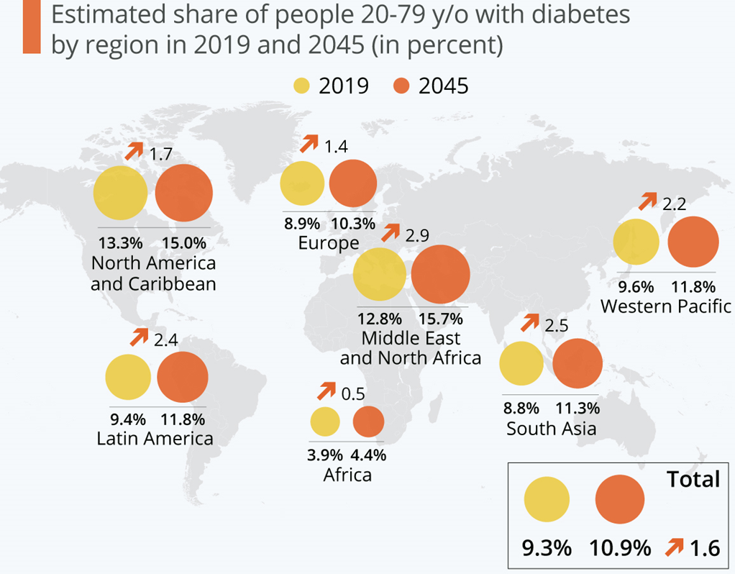
RISE IN RATES OF DIABETES
Data from 2019 showed that 463 million people (ages 20-79) suffered from diabetes worldwide (9.3% of the world population in this age group).
By 2045, this number is projected to increase to 700.1 million (10.9% of the global population). [15]

Slide 5
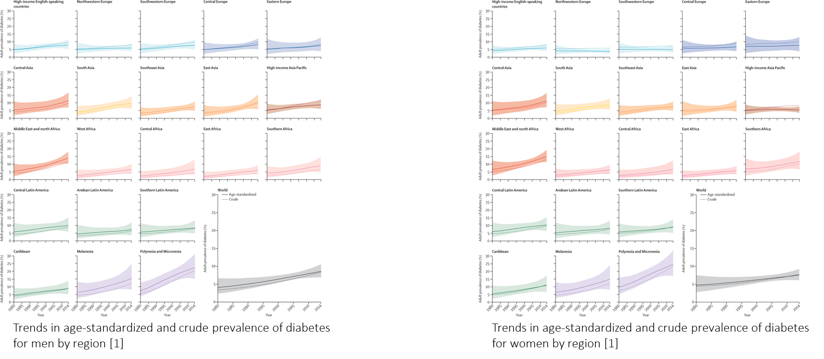
The global economic burden of diabetes may rise from $1.3 trillion in 2015 to $2.2 trillion by 2030 if current trends continue [4].

Slide 6
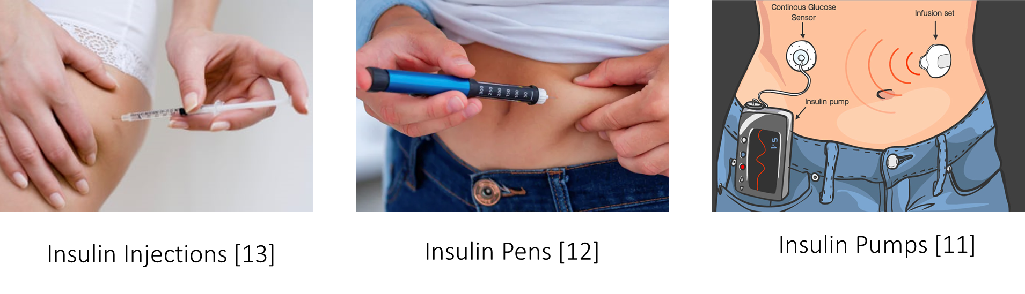
CURRENT TECHNOLOGIES IN INSULIN THERAPY

Slide 7
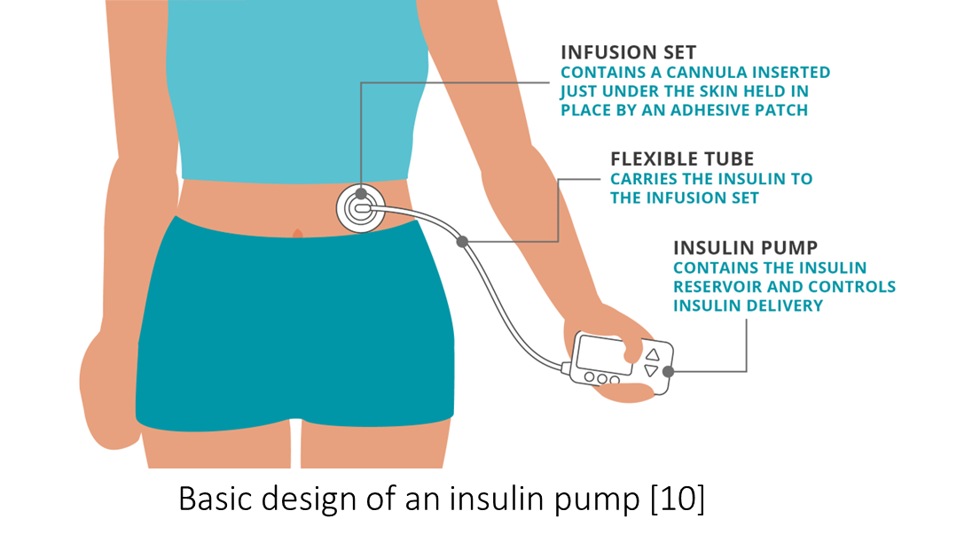
INSULIN PUMPS
Personalized insulin delivery devices which continuously deliver insulin through a thin catheter inserted into subcutaneous tissue, mimicking the body's natural insulin production.

Slide 8
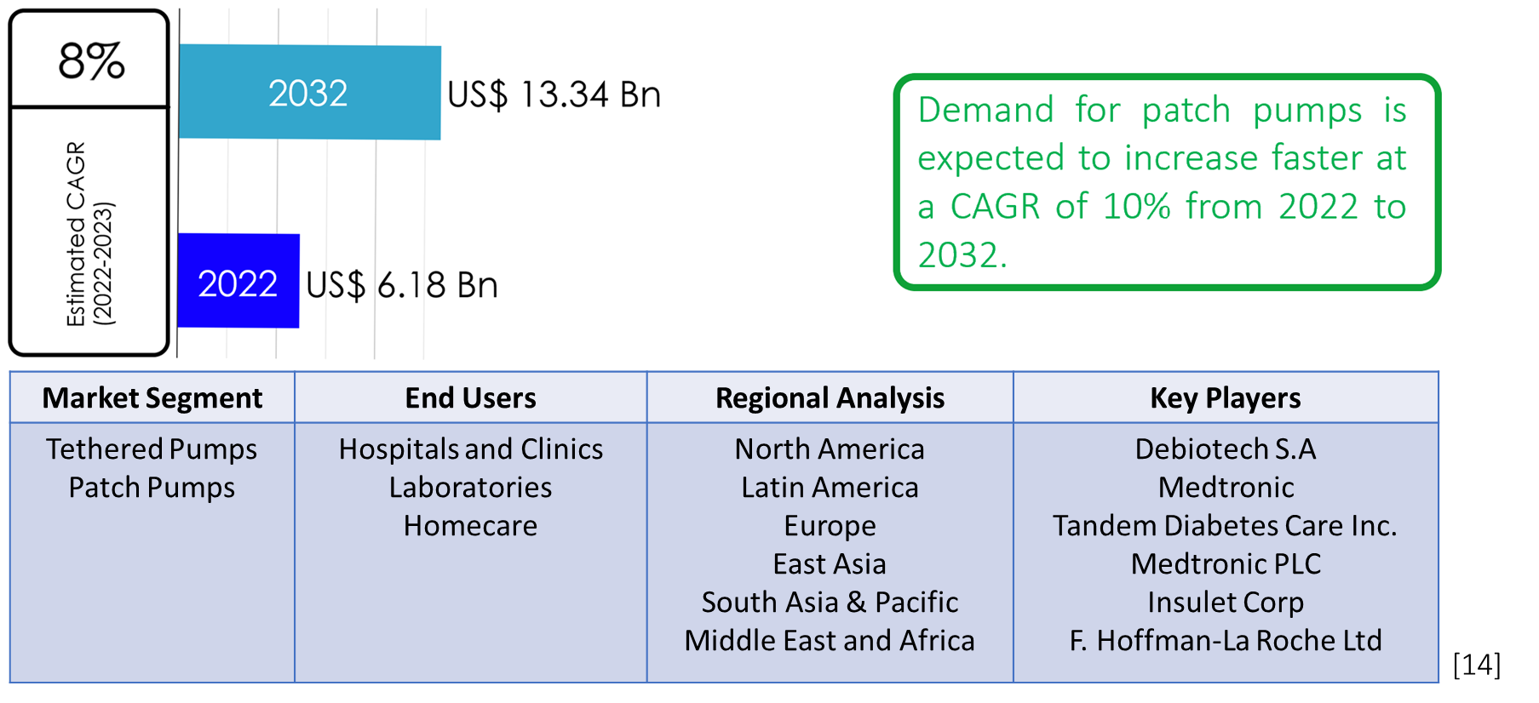
CURRENT MARKET FOR INSULIN PUMPS

Slide 9
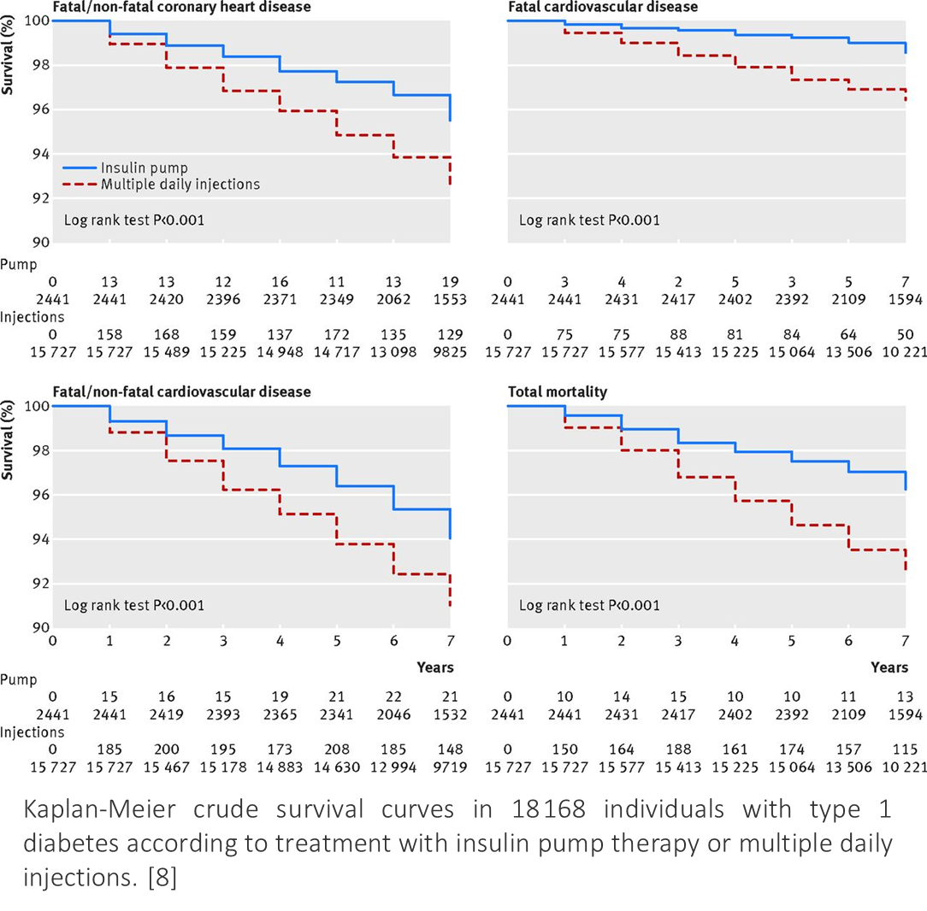
Insulin pumps offer several advantages over traditional insulin injection methods, including:
•Precise Insulin Delivery
•Enhanced Flexibility in Meal Planning
•Improved Glycemic Control
•Reduced Risk of Complications
•Increased Quality of Life

Slide 10
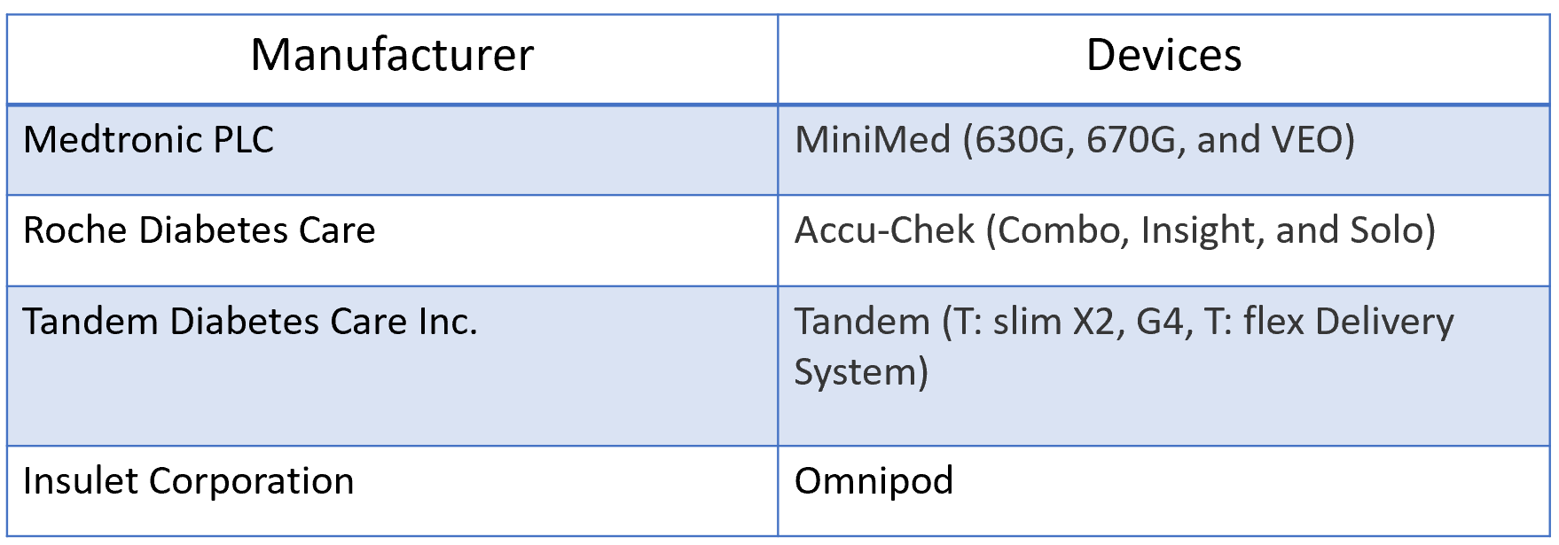
TOP SELLERS IN THE CATEGORY
North America is the largest consumer of insulin pumps and consists 45.8% of the market as of November 2023. [16]

Slide 11
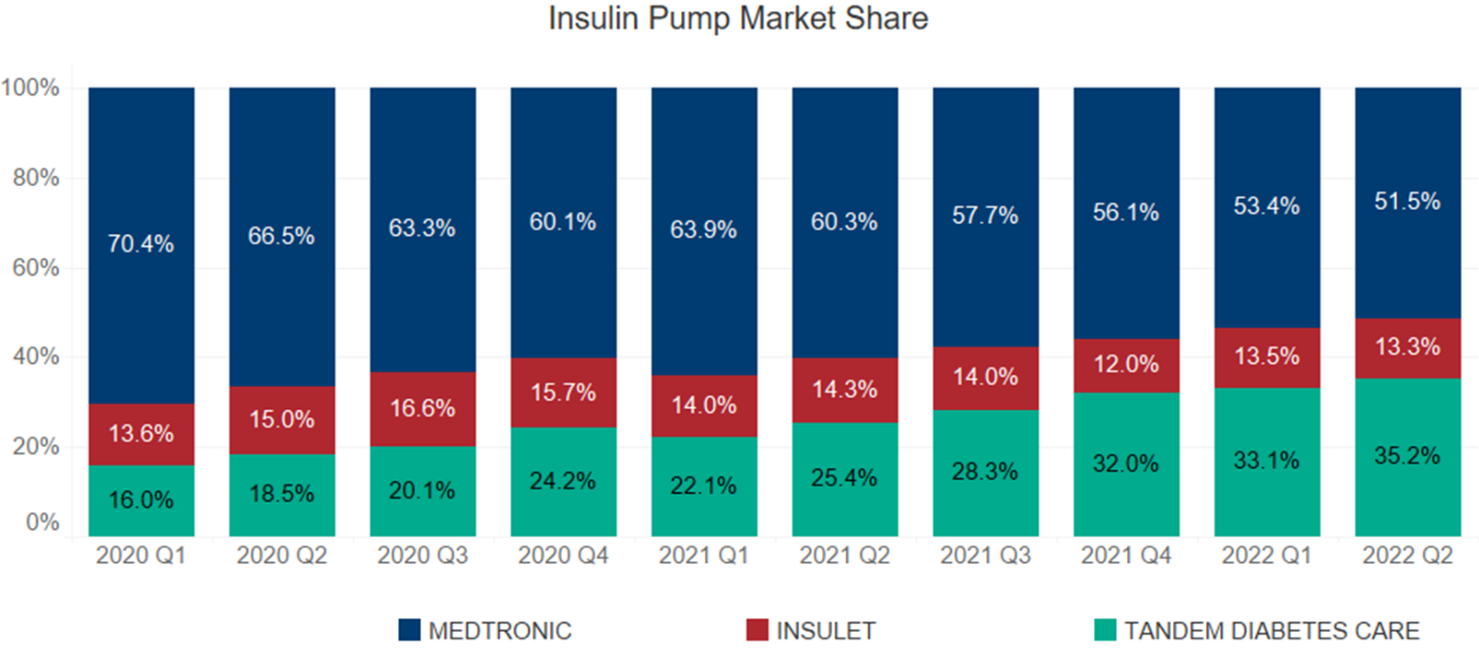
Medtronic continues to be the top seller for insulin pumps and its accessories, however as of 2022, Insulet and Tandem have begun to substantially capture market share. [17]

Slide 12
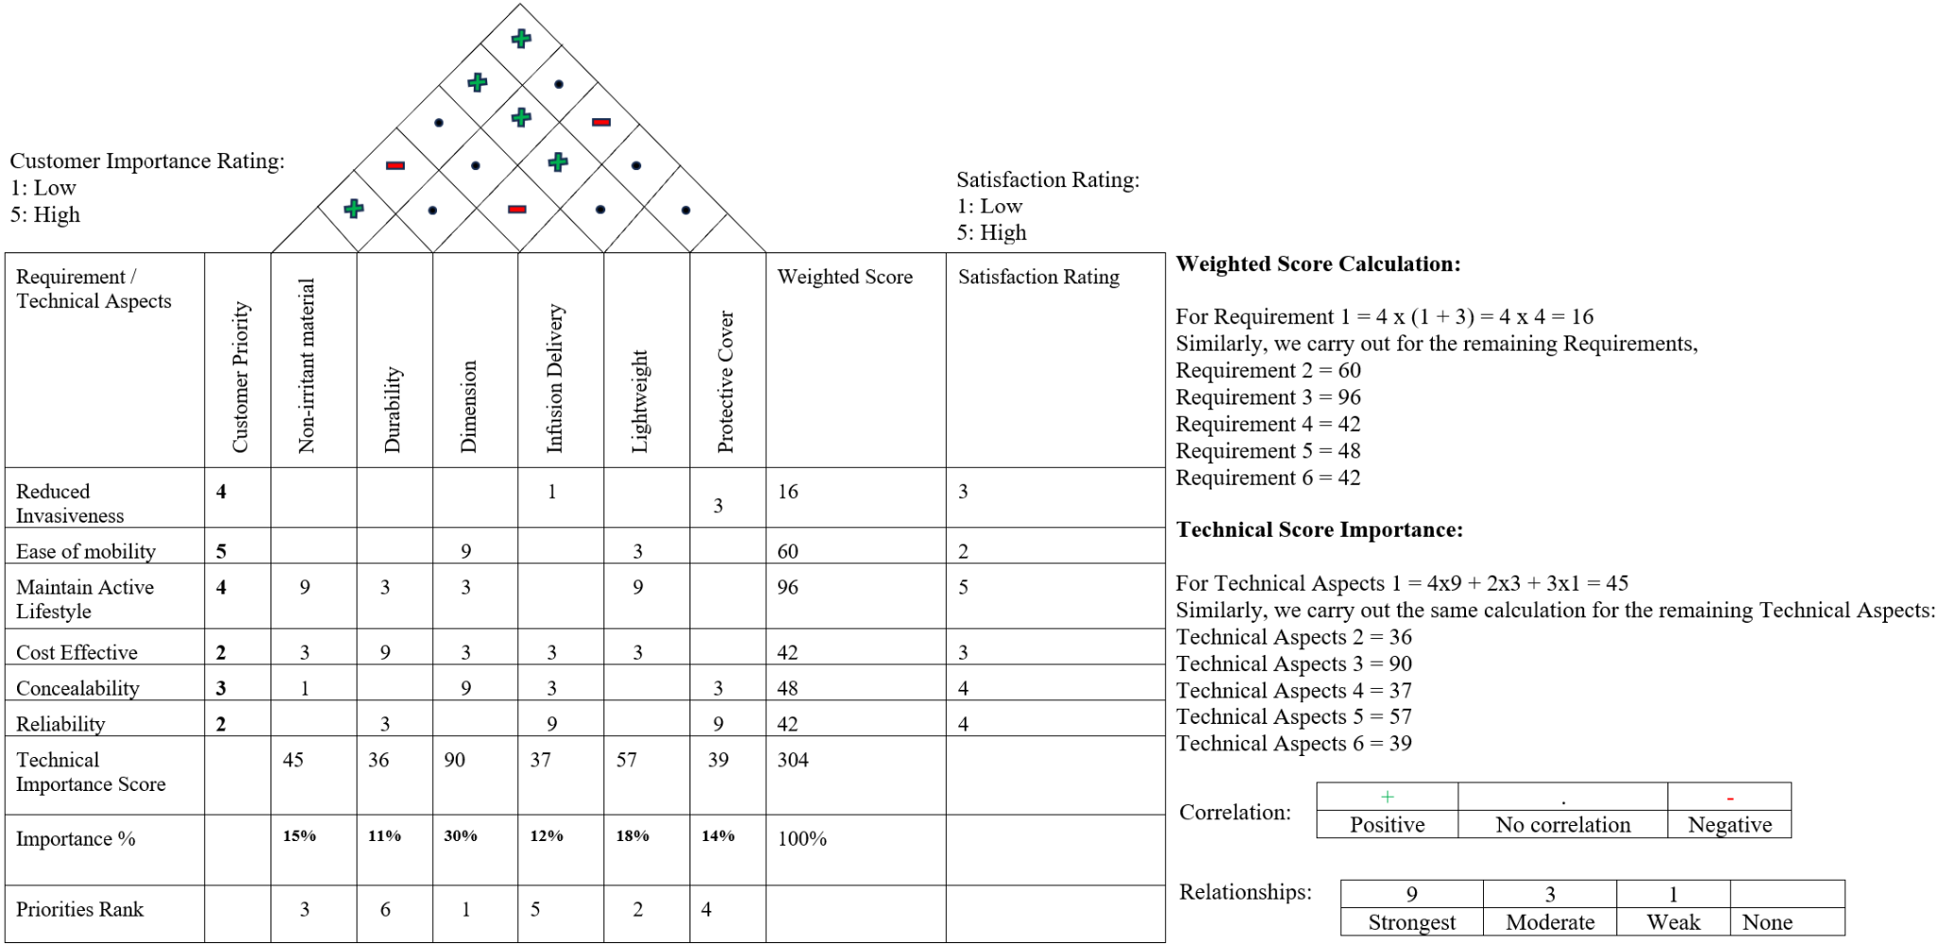
QFD

Slide 13
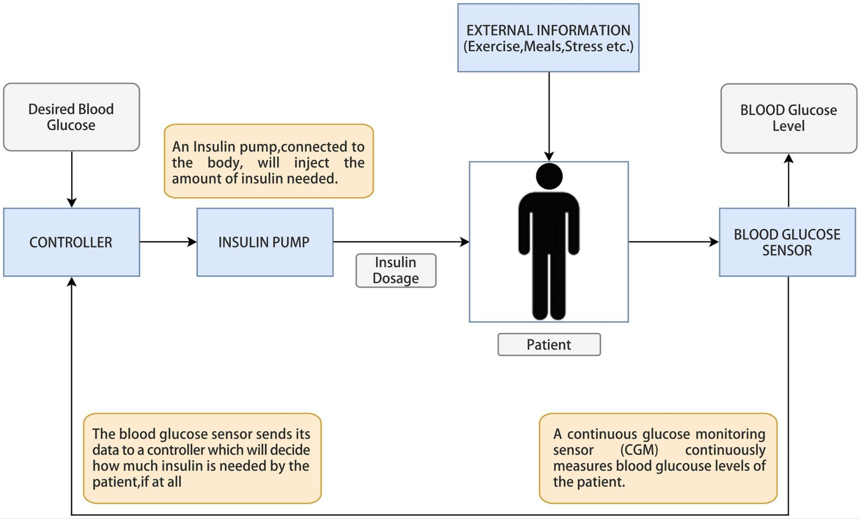
OVERALL MECHANISM OF OPERATION

Slide 14
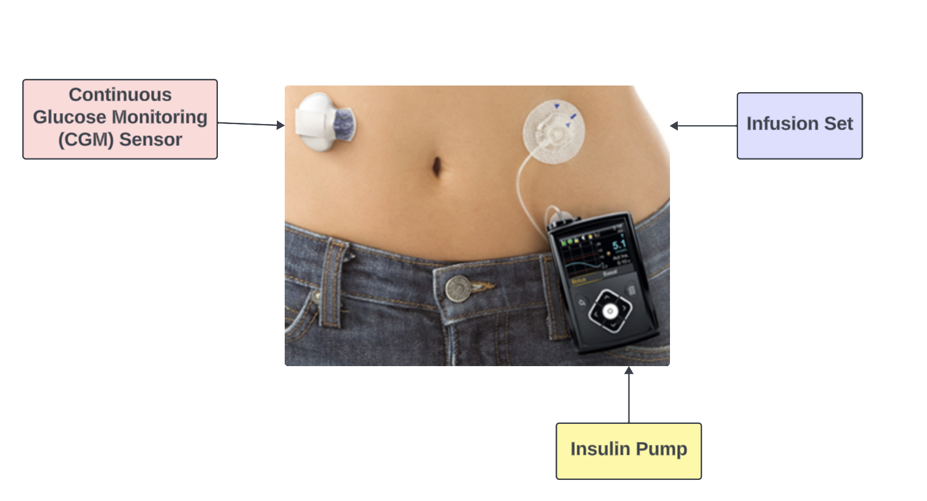
DESIGN INSPIRATION
MEDTRONIC MINI-MED 780G System

Slide 15
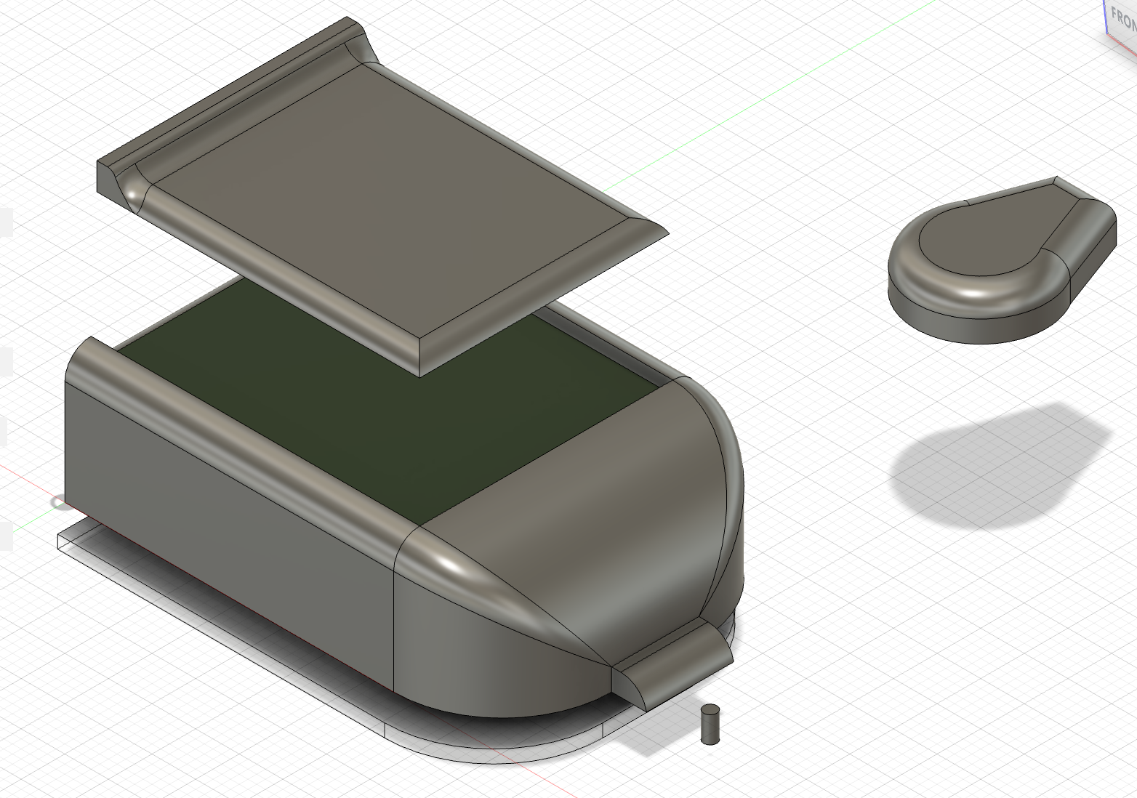
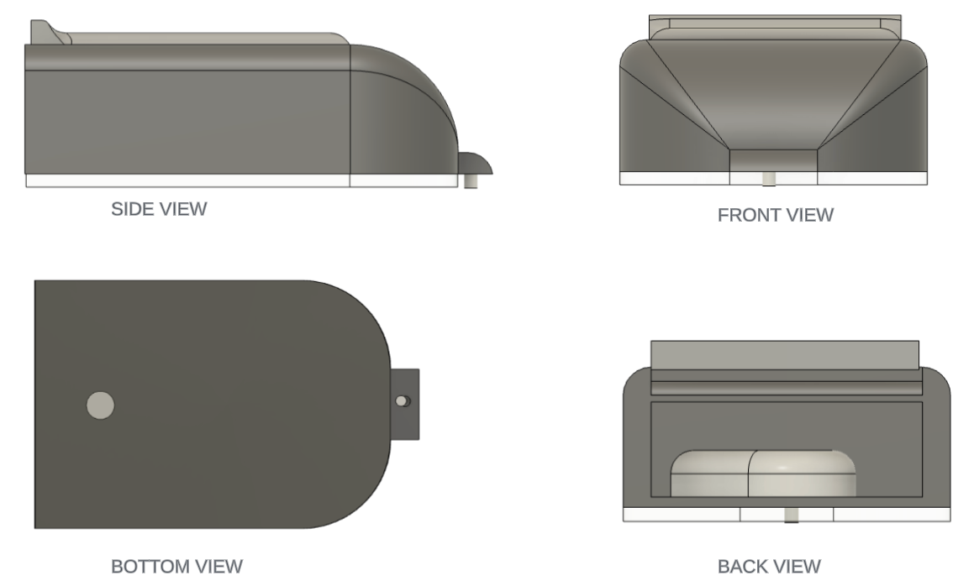
OUR DESIGN CONSIDERATIONS
Sleek, Modular, Integrated Body-Adherent Unit (54mmx35mmx15mm)
Replacement of Push Buttons with Touch-screen functionality
Screen Flap
Biocompatible Adhesive for adherence
Replacement of Cannula-designed CGM with Optical CGM sensor
Replacement of infusion set cannula with Micro-Array Needle
Lightweightedness

Slide 16
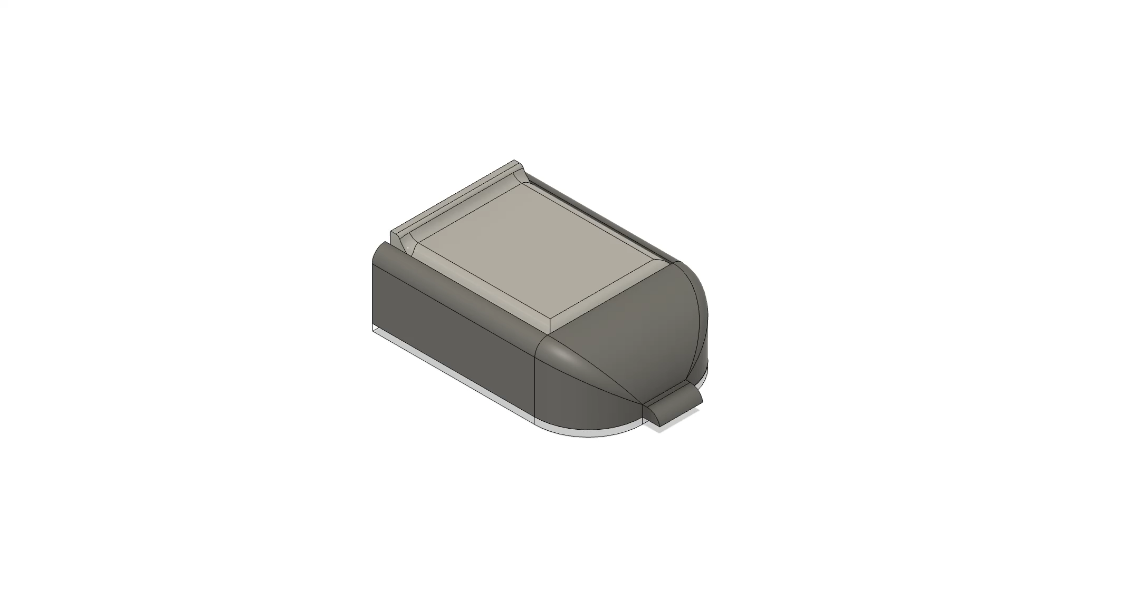
SIMULATION

Slide 17
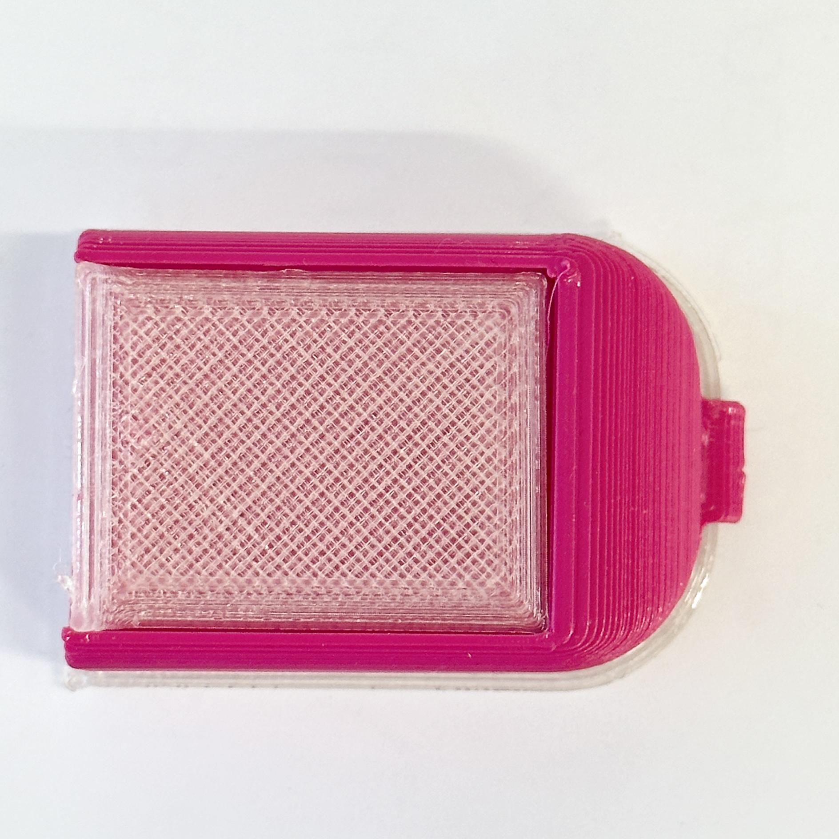
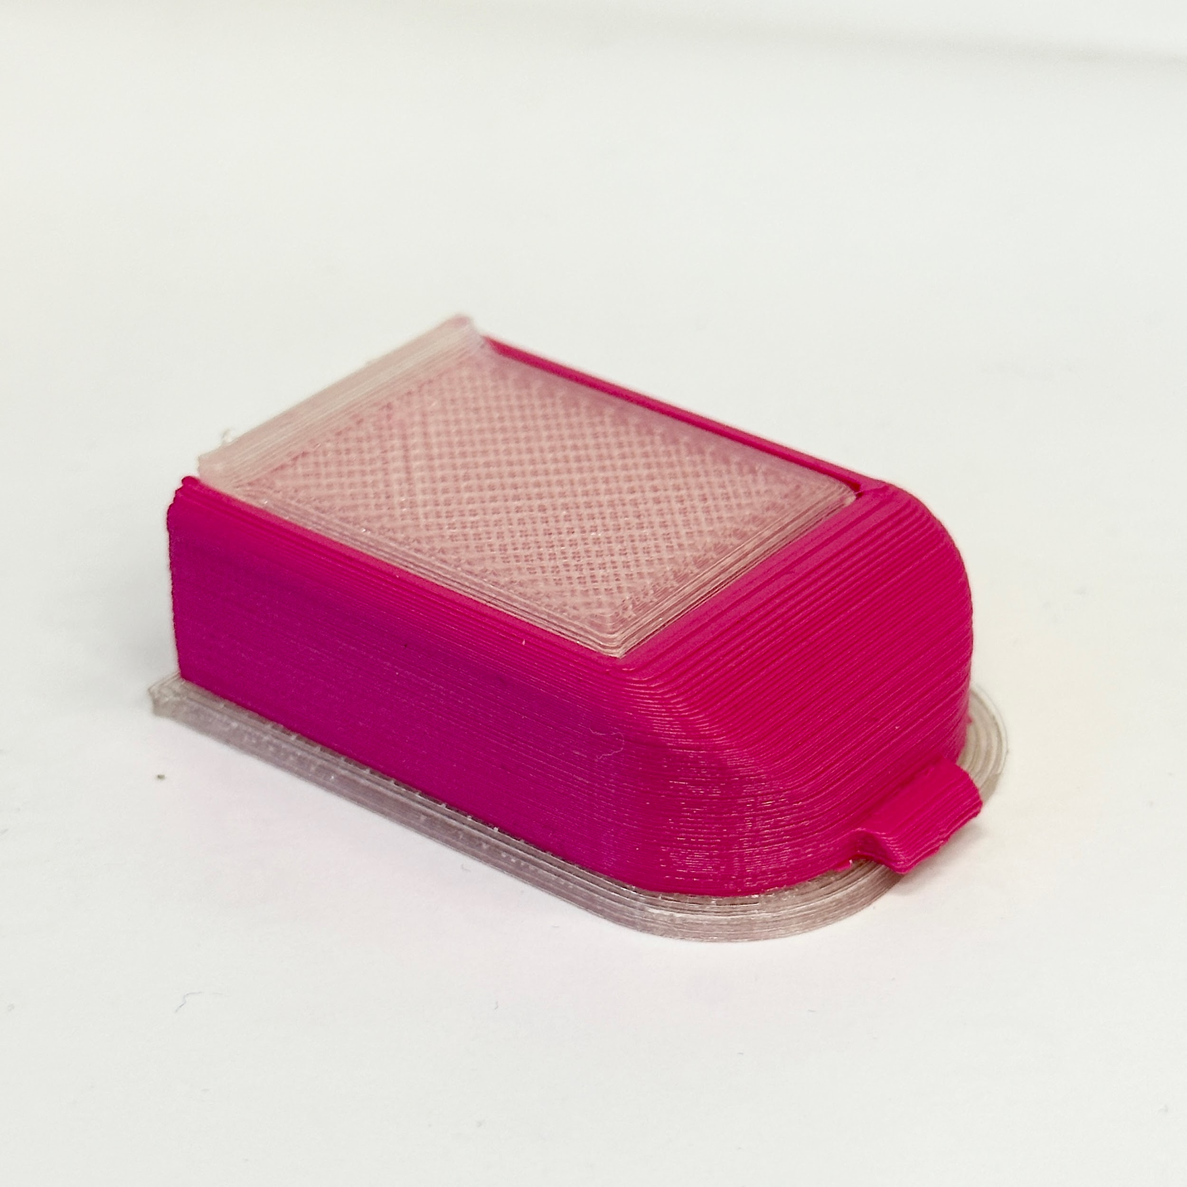
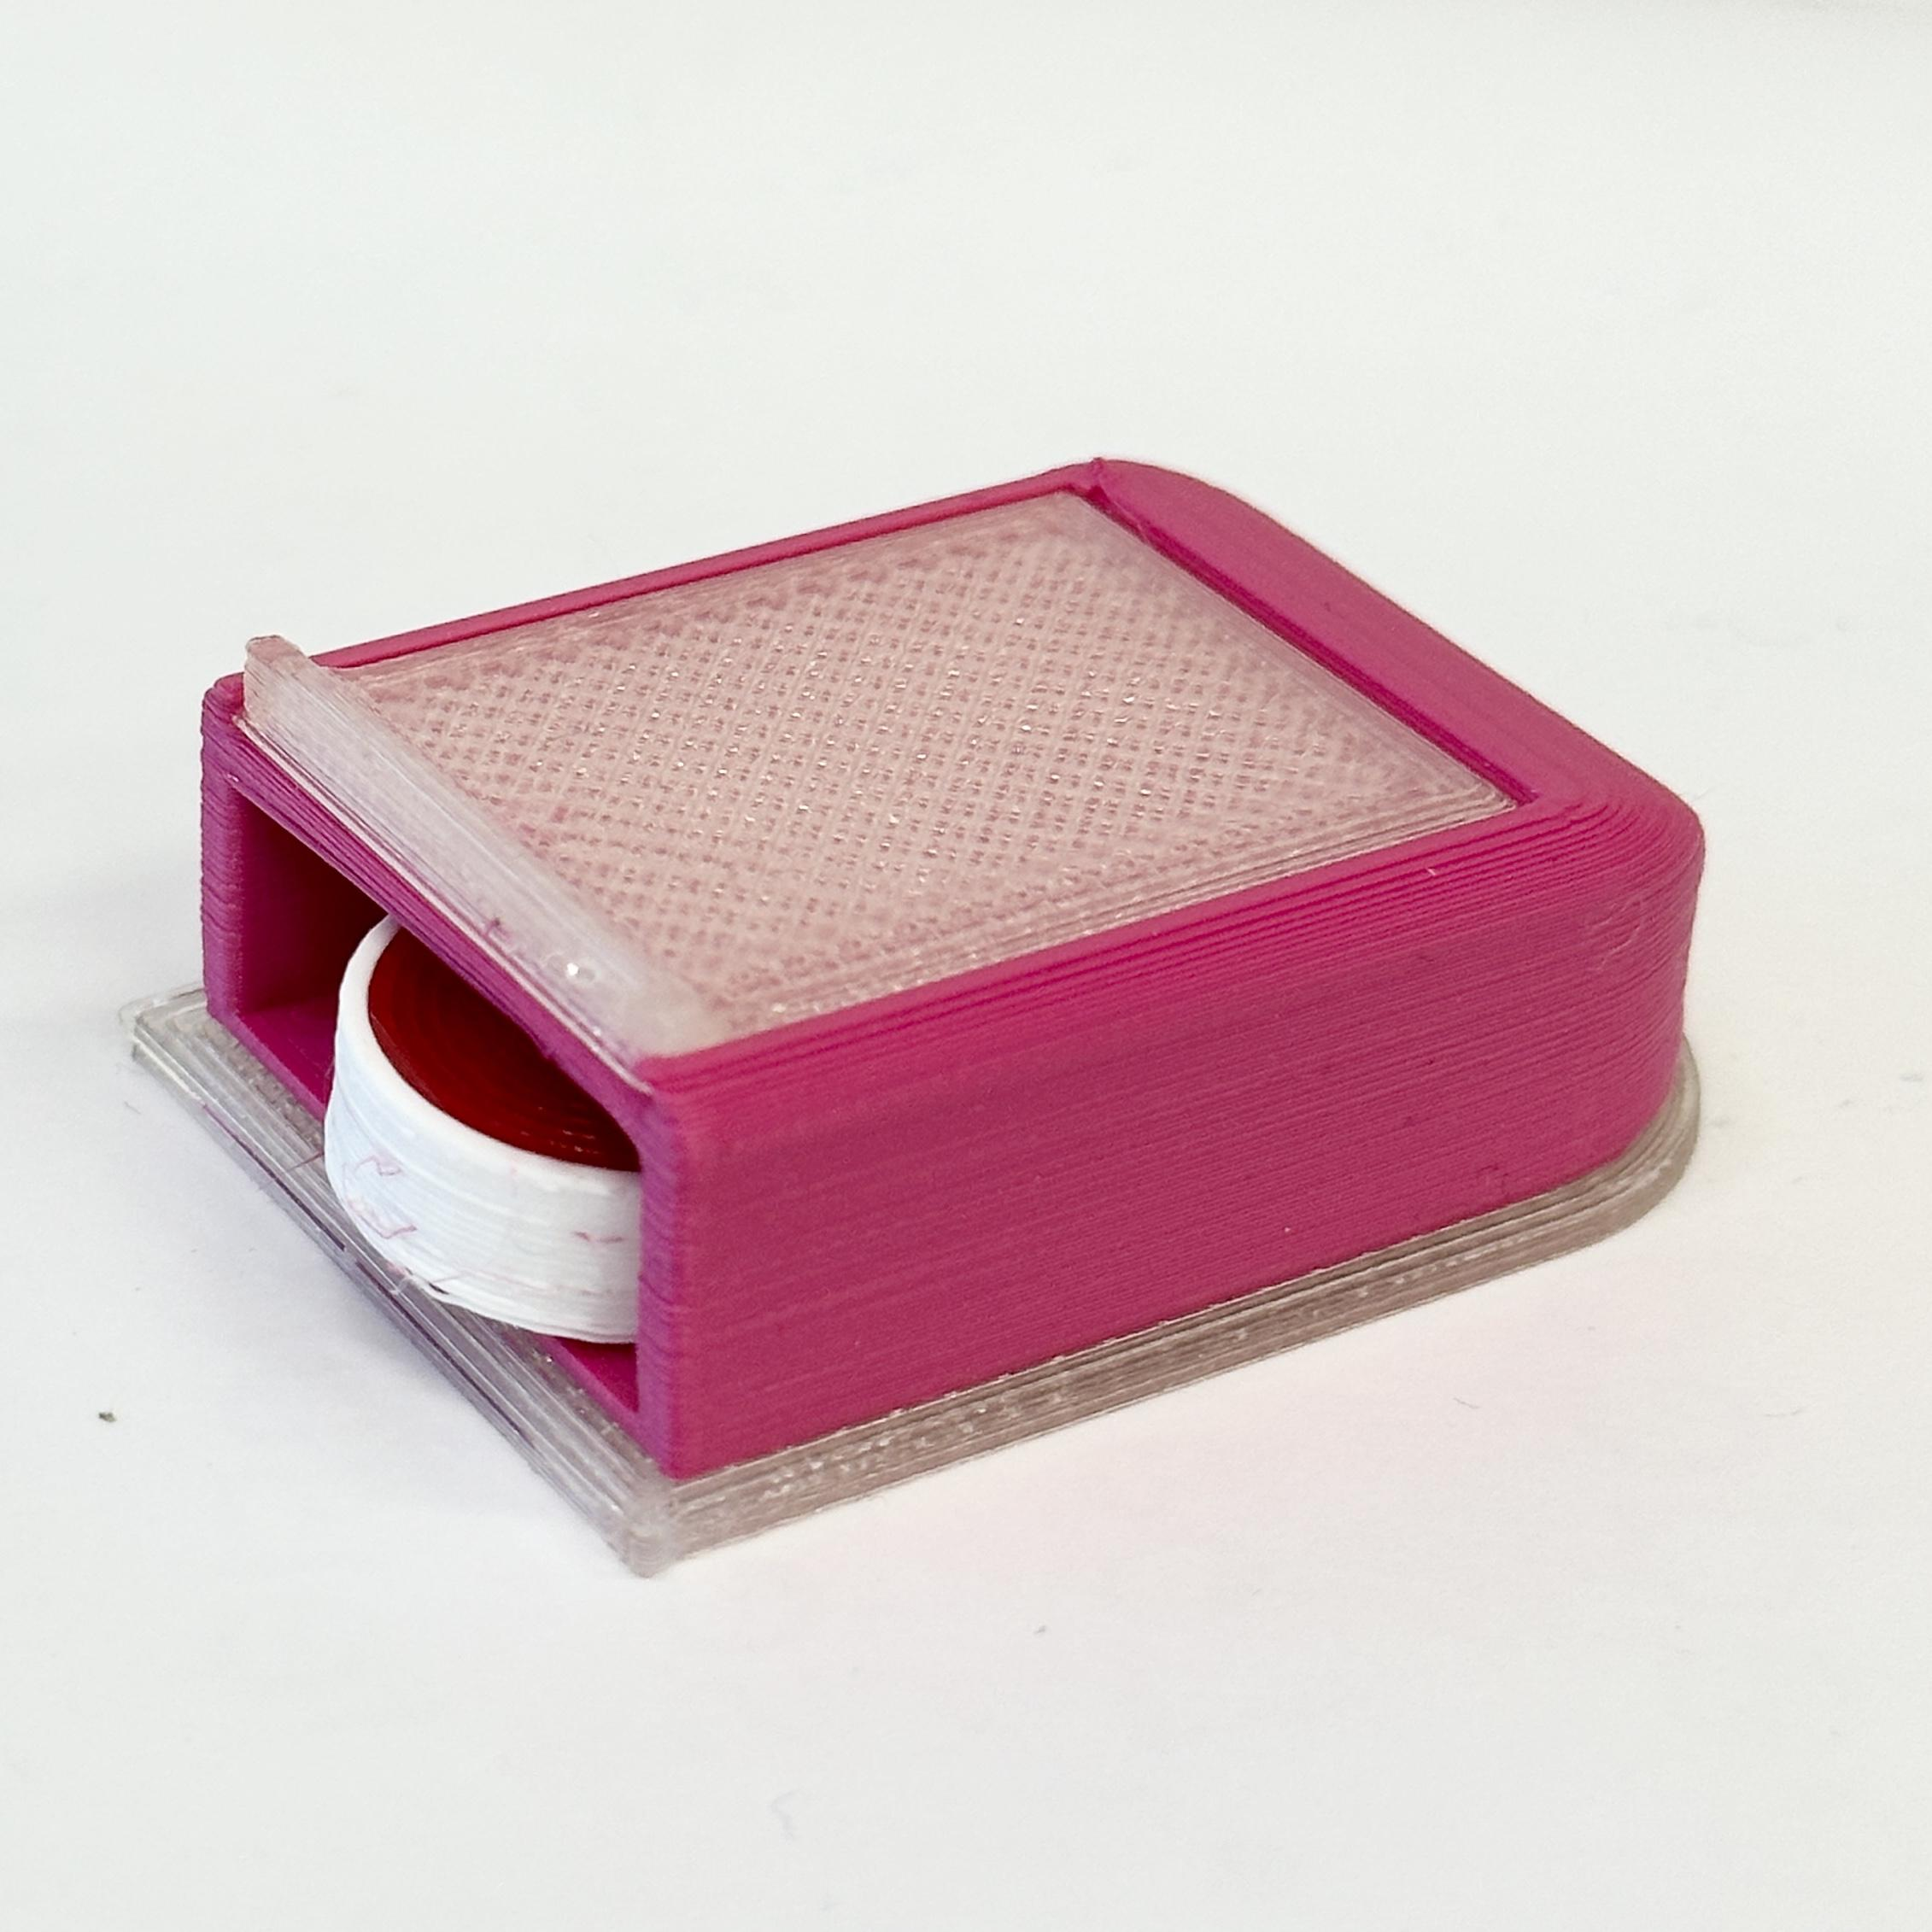
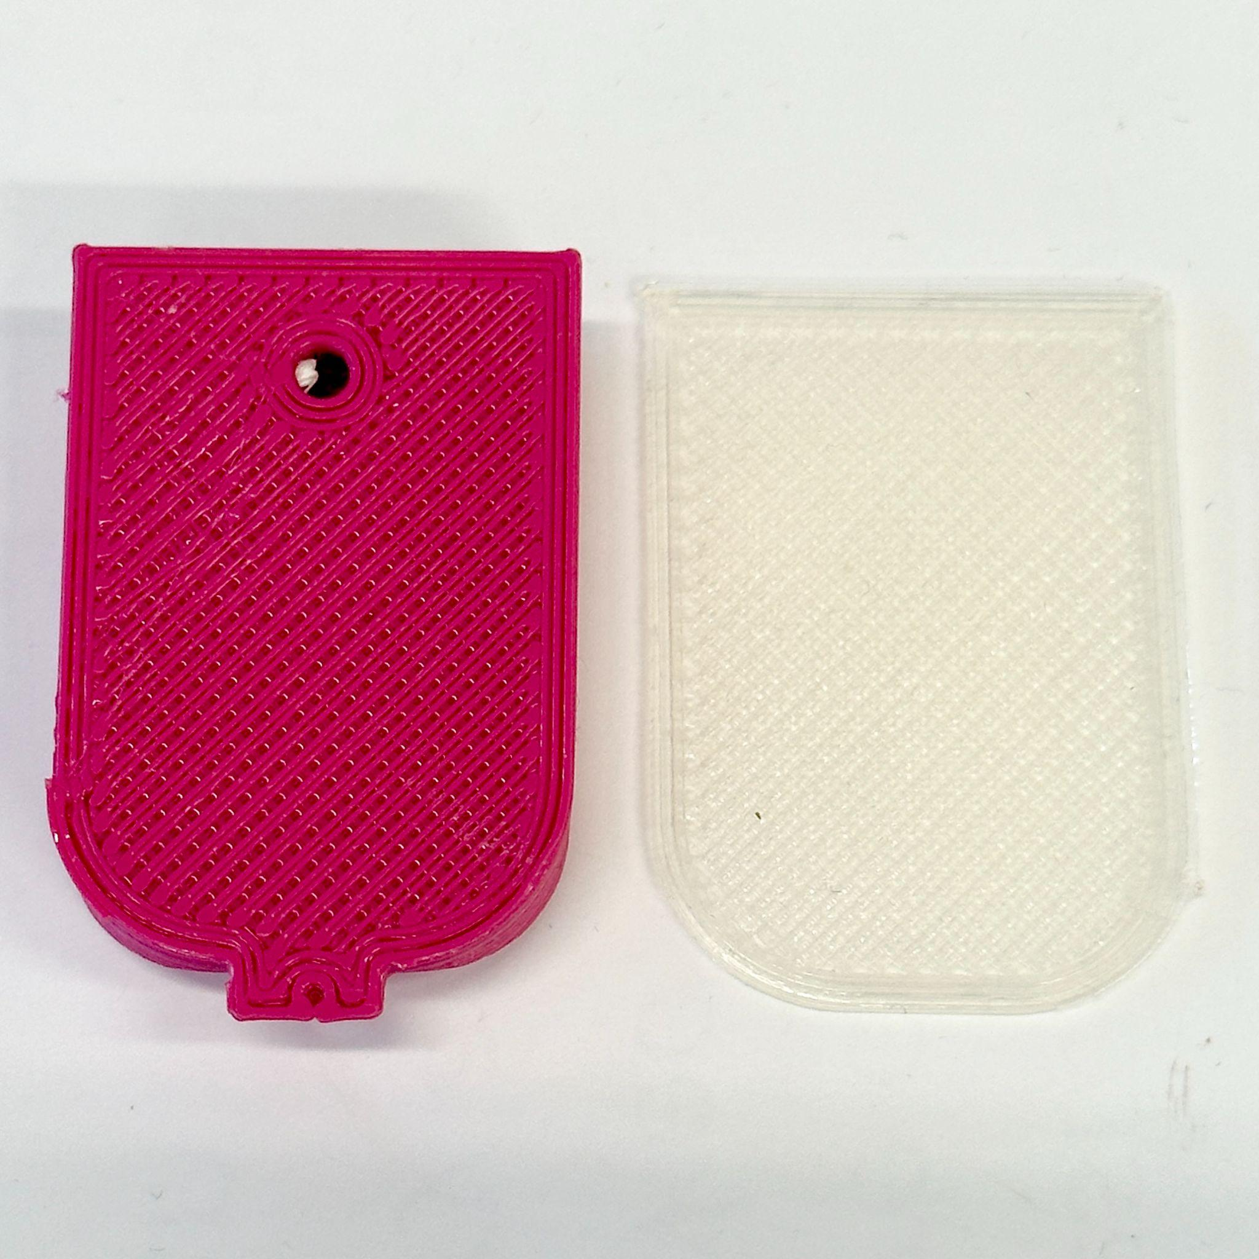
FINAL DESIGN
PERSPECTIVE VIEWS
Notes:
SYSTEM CHASIS - TPE
INSULIN RESERVOIR - POLYPROPYLENE
INFUSION SET - TEFLON/POLYURETHANE FOR BOTH CANULA AND TUBING
DUE TO LIMITATIONS,
-PLA FOR ENTIRE SYSTEM, TPU FOR ADHESIVE

Slide 18
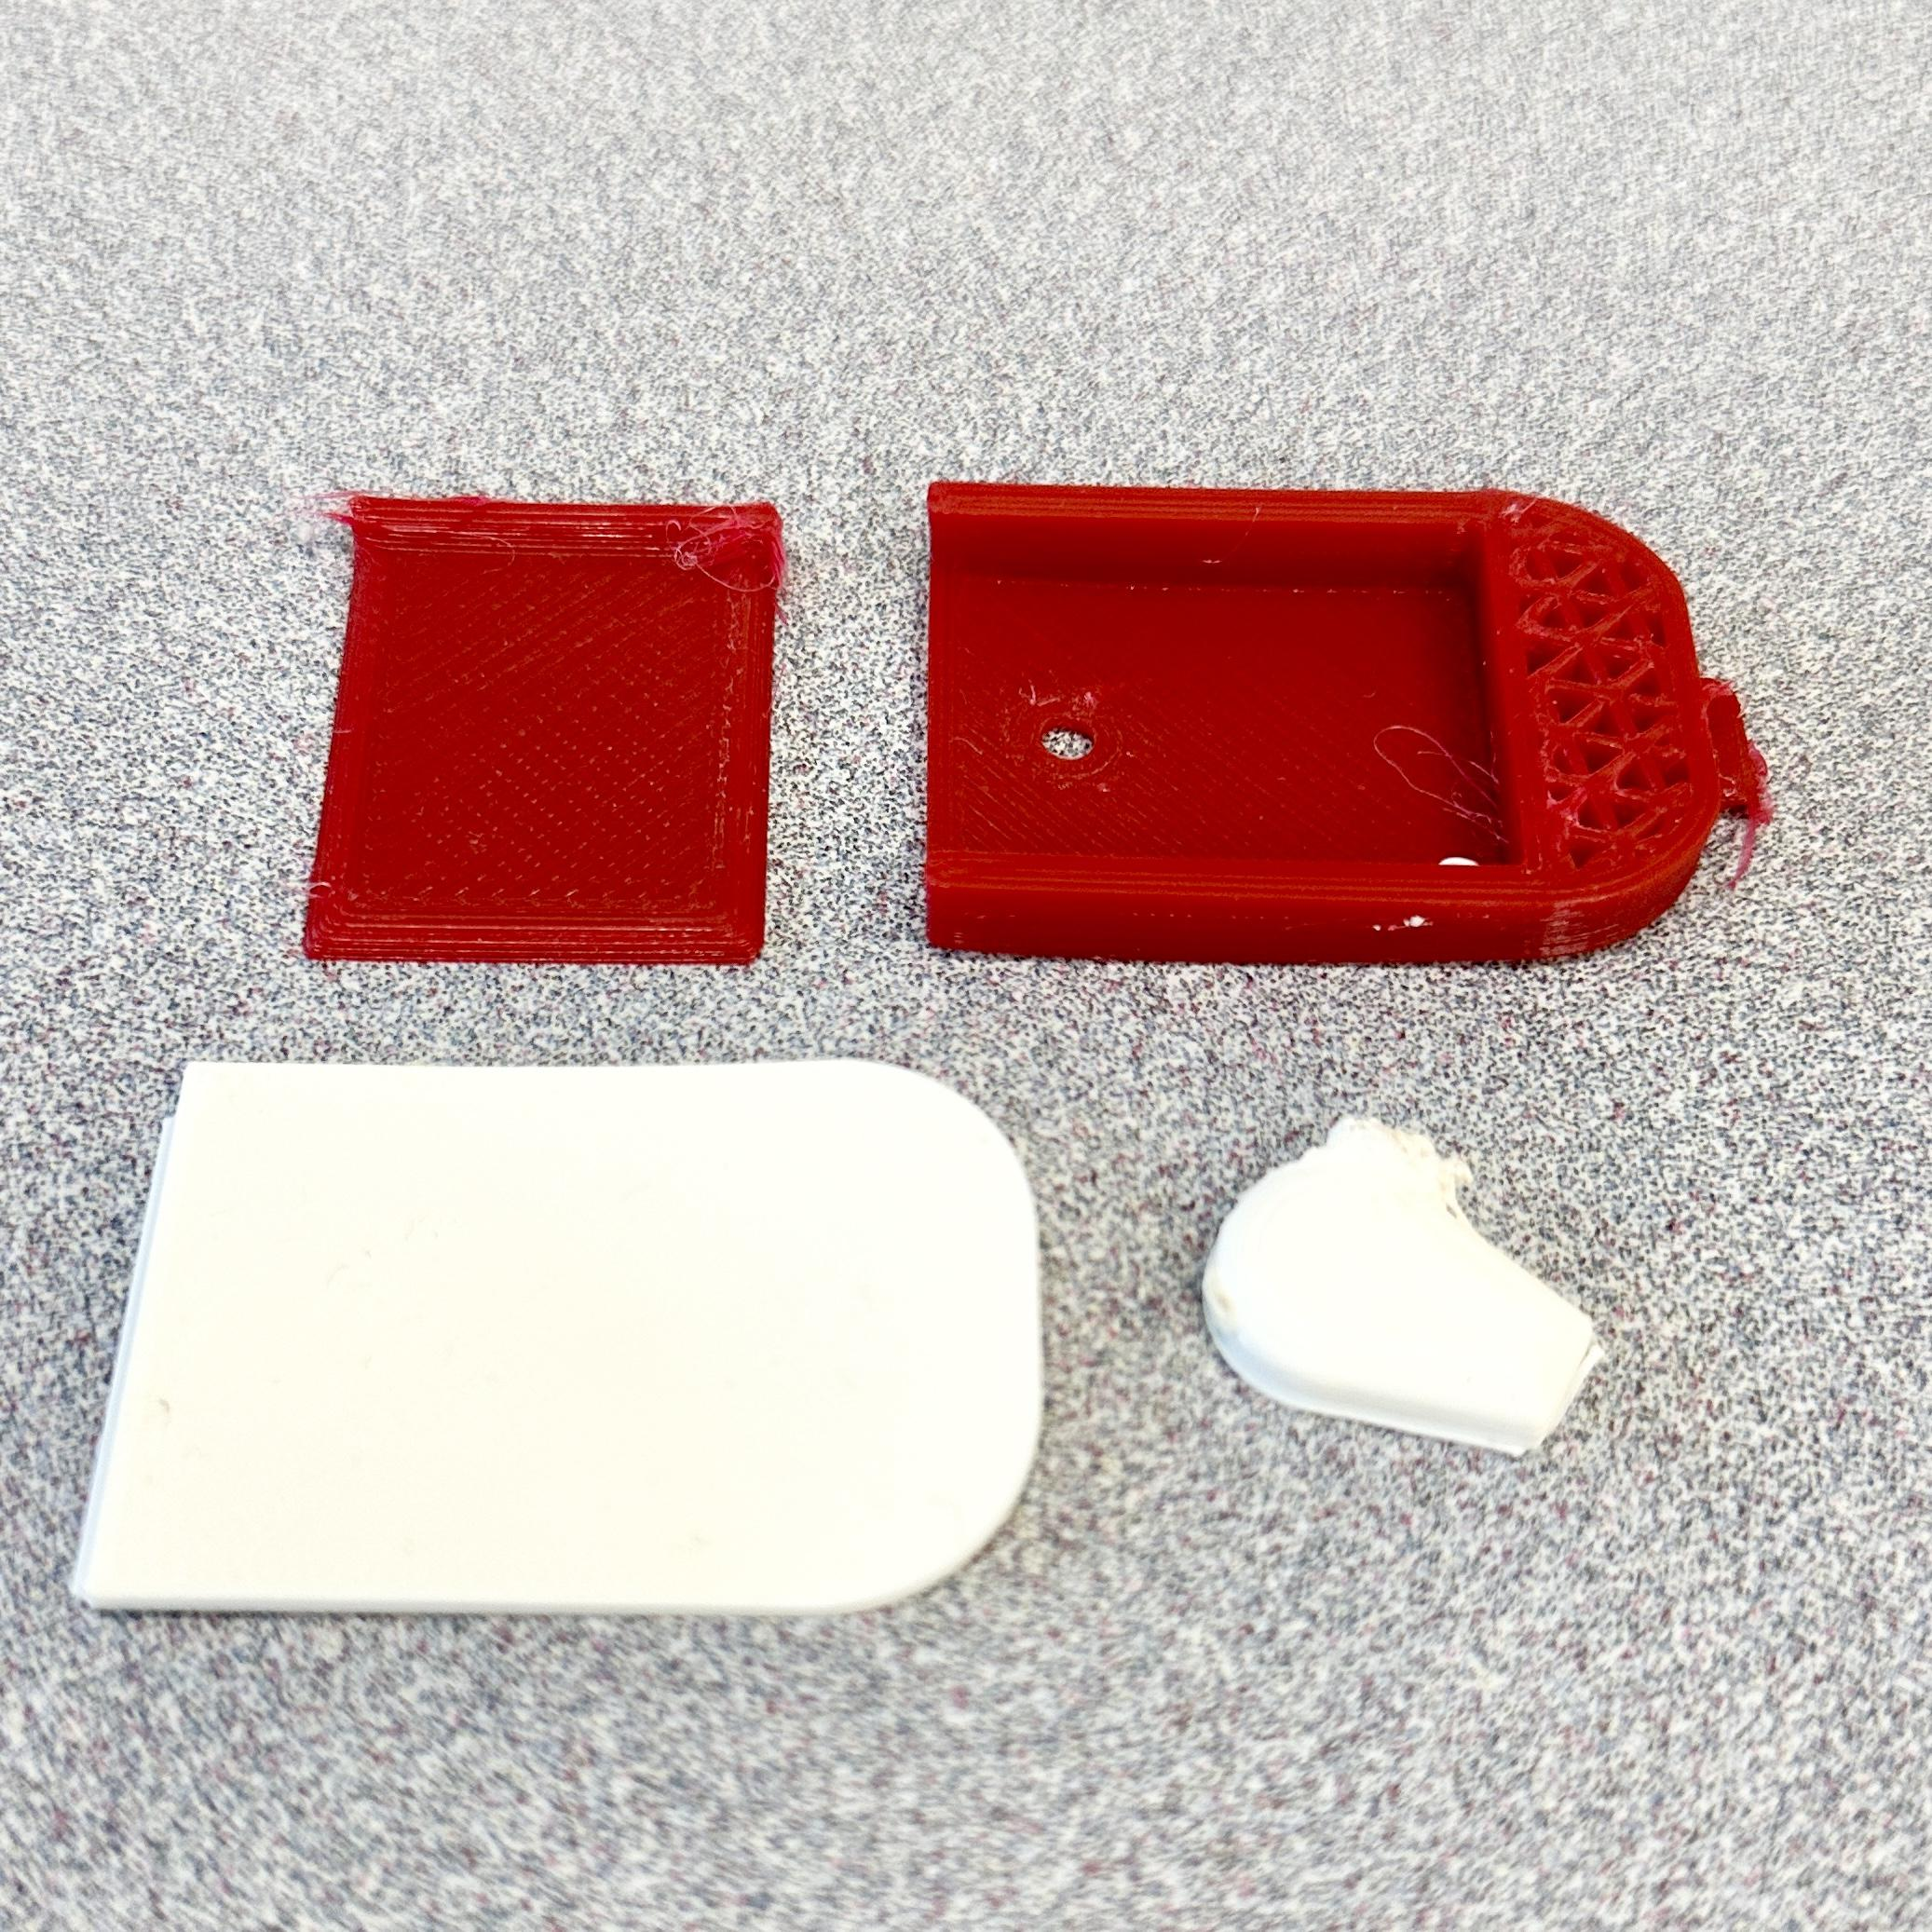
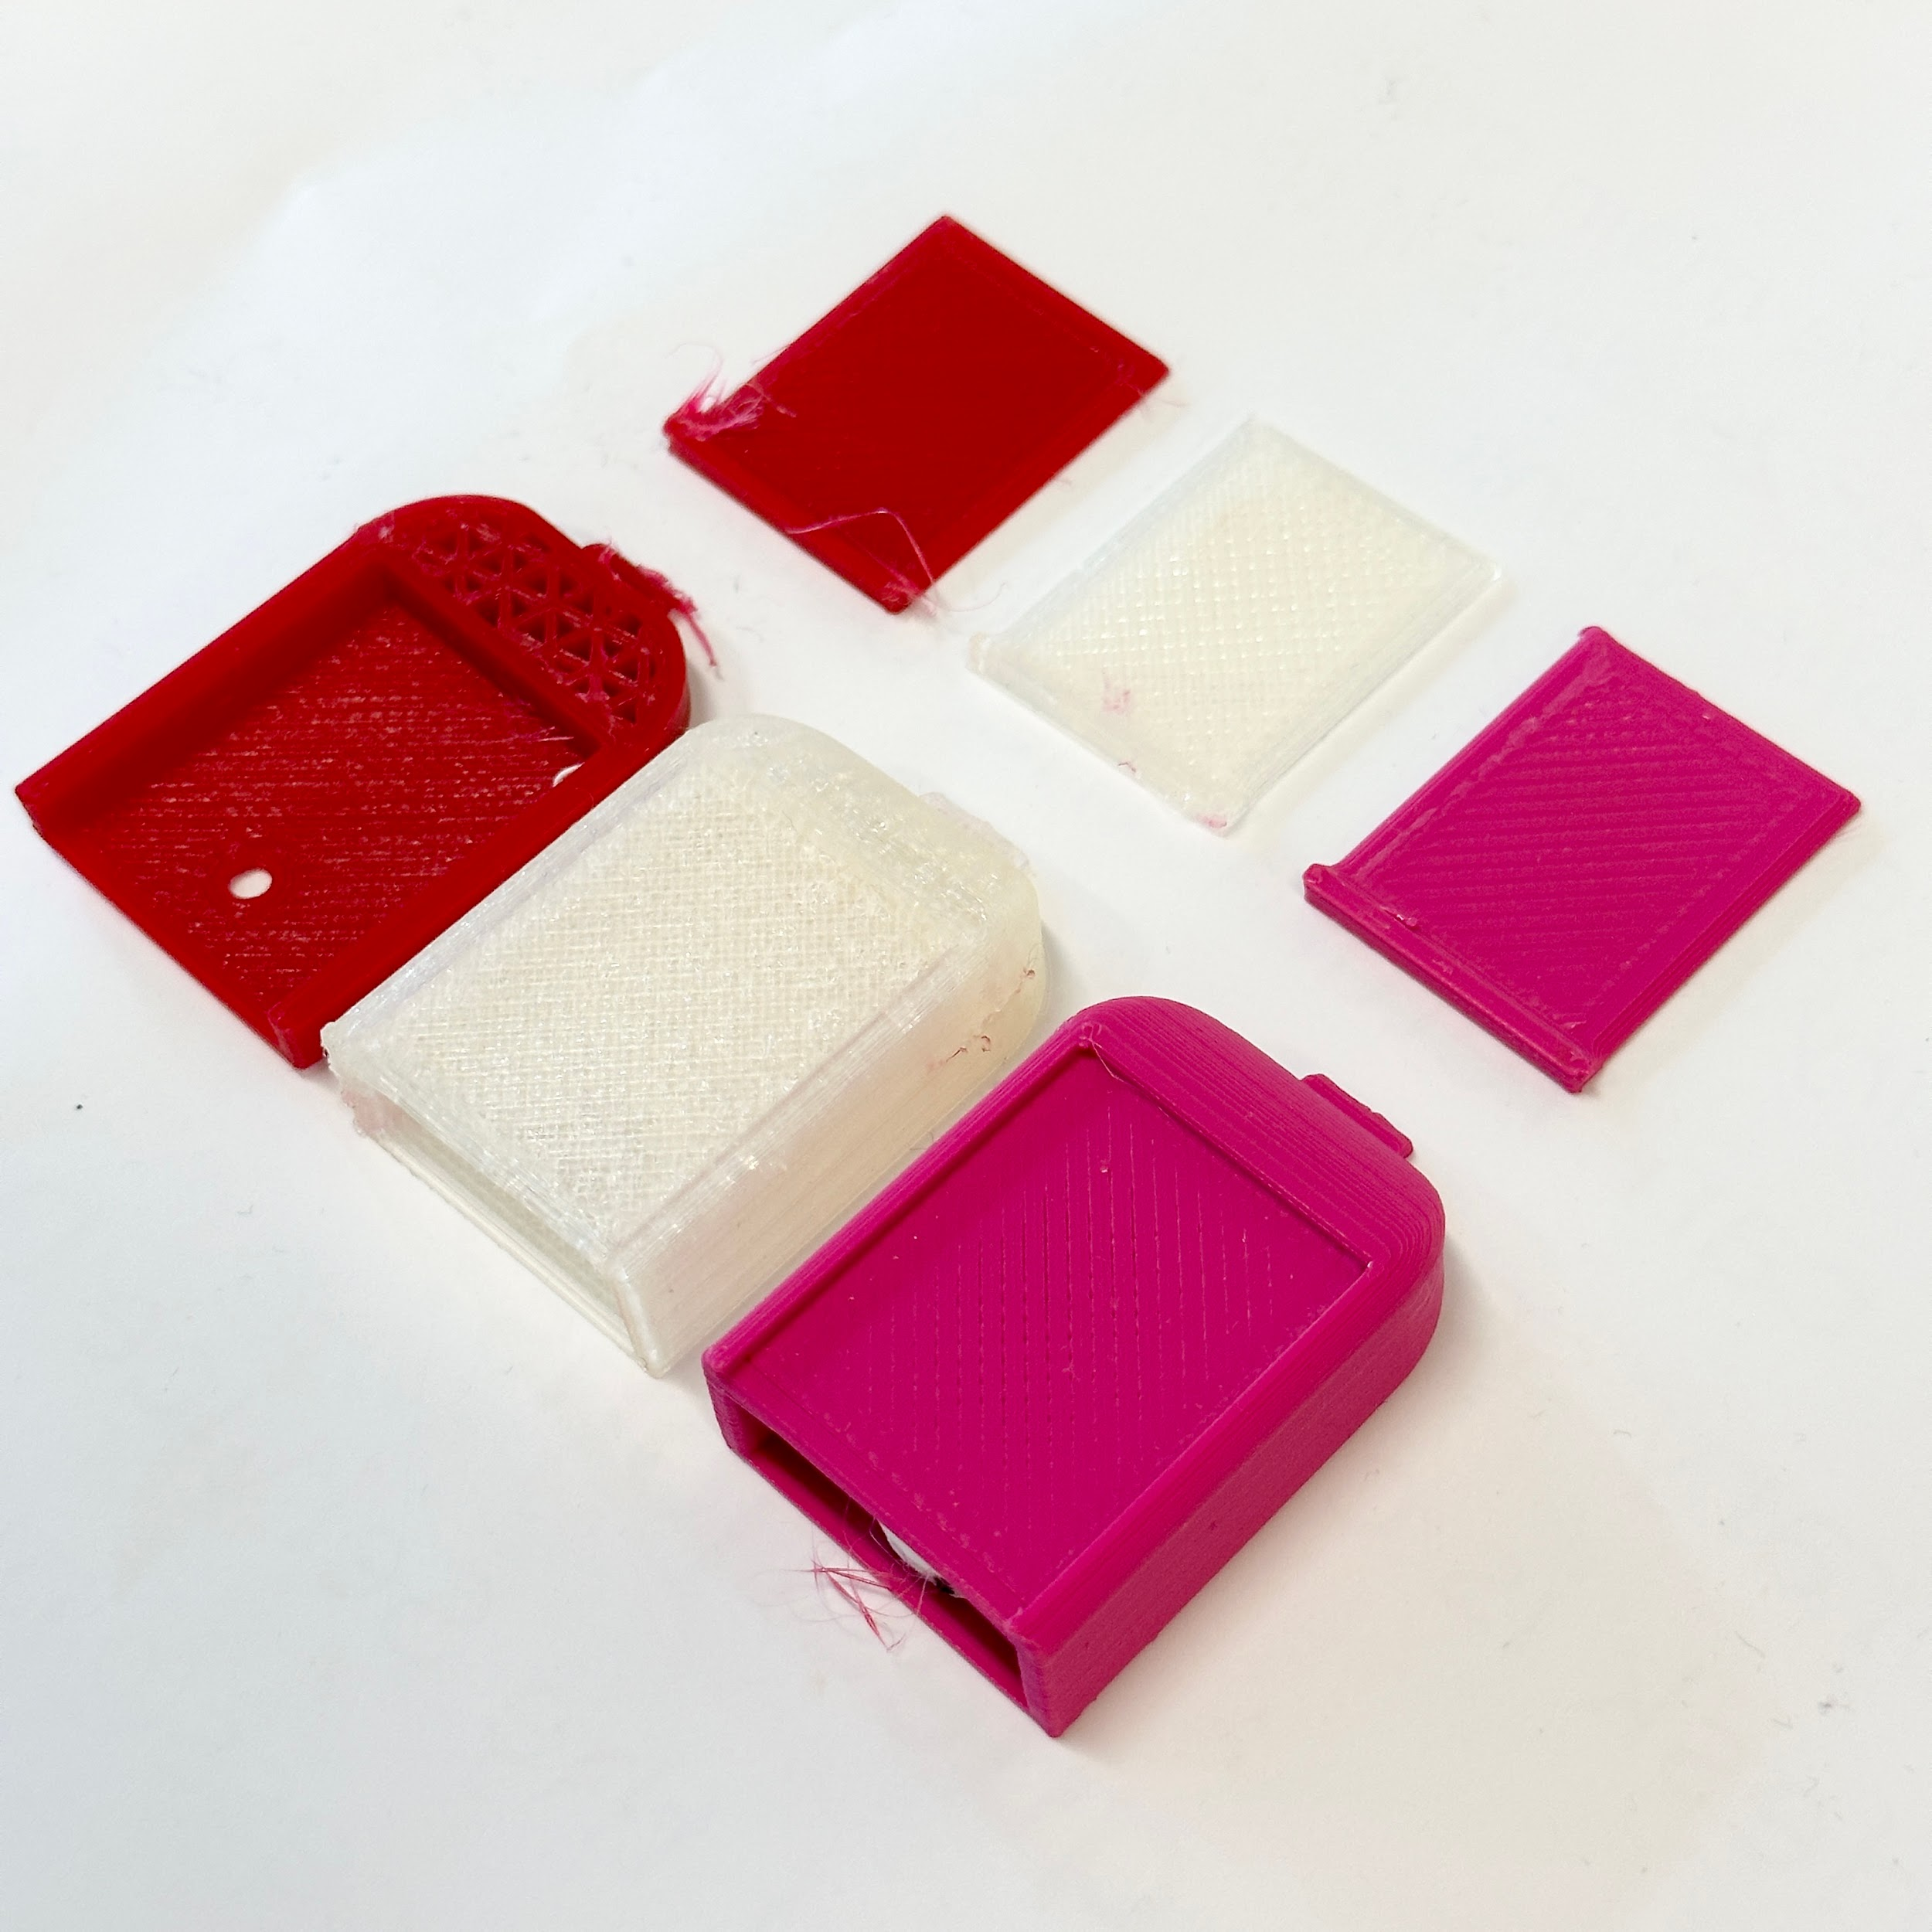
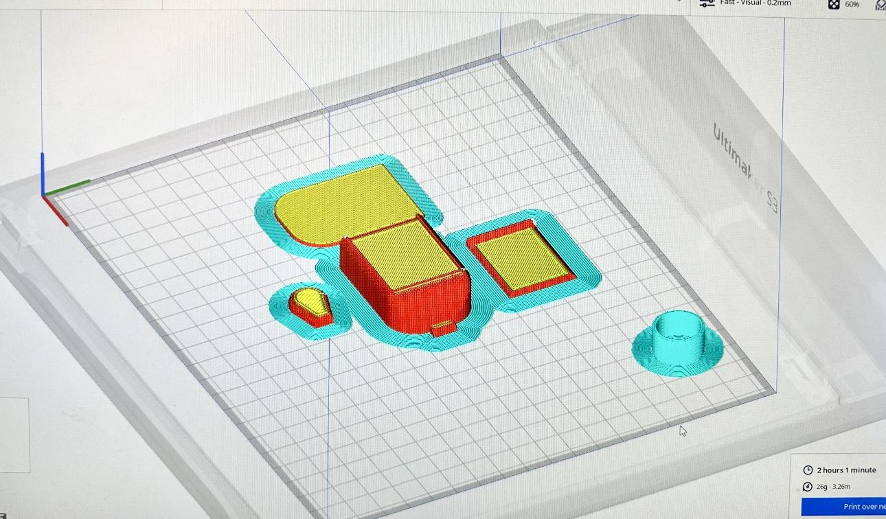
3D printing trials
PROTOTYPING FLAWS AND FAILURES
Disintegration
Material failure
Transparency

Slide 19
MATERIALS
System Chassis
Material: Thermoplastic Elastomer (TPE) (Soft-touch, Good range of motion, chemical resistance, electrical insulation)
Insulin Reservoir
Material: Polypropylene (Ideal for safe insulin storage, Durable)
Infusion set cannula tubing
Material: Nylon (Combined strength and flexibility, kink-resistant, chemically inert for smooth insulin delivery)
Adhesive System :
Material: Silicone Adhesive (Gentle Adhesion, Long-term wear)
Notes:
SYSTEM CHASIS - TPE
INSULIN RESERVOIR - POLYPROPYLENE
INFUSION SET - TEFLON/POLYURETHANE FOR BOTH CANULA AND TUBING
DUE TO LIMITATIONS,
-PLA FOR ENTIRE SYSTEM, TPU FOR ADHESIVE

Slide 20
MATERIAL SELECTION
Due to limitations,
PUMP SYSTEM MATERIAL :
First Consideration: THERMOPLASTIC POLYURETHANE (TPU)
Final Consideration: POLYLACTIC ACID (PLA)
ADHESIVE SYSTEM MATERIAL :
First Consideration: SILICONE ADHESIVE
Final Consideration: TPU, PLA
Notes:
SYSTEM CHASIS - TPE
INSULIN RESERVOIR - POLYPROPYLENE
INFUSION SET - TEFLON/POLYURETHANE FOR BOTH CANULA AND TUBING
DUE TO LIMITATIONS,
-PLA FOR ENTIRE SYSTEM, TPU FOR ADHESIVE TPU was way to soft and wont provide stability and user needs something strong and sturdy.

Slide 21
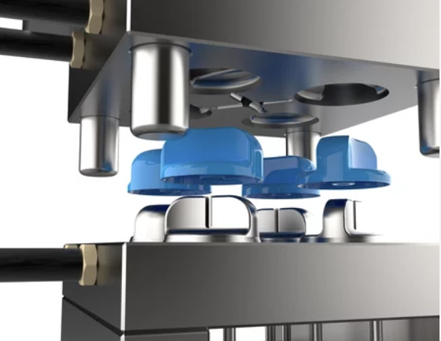
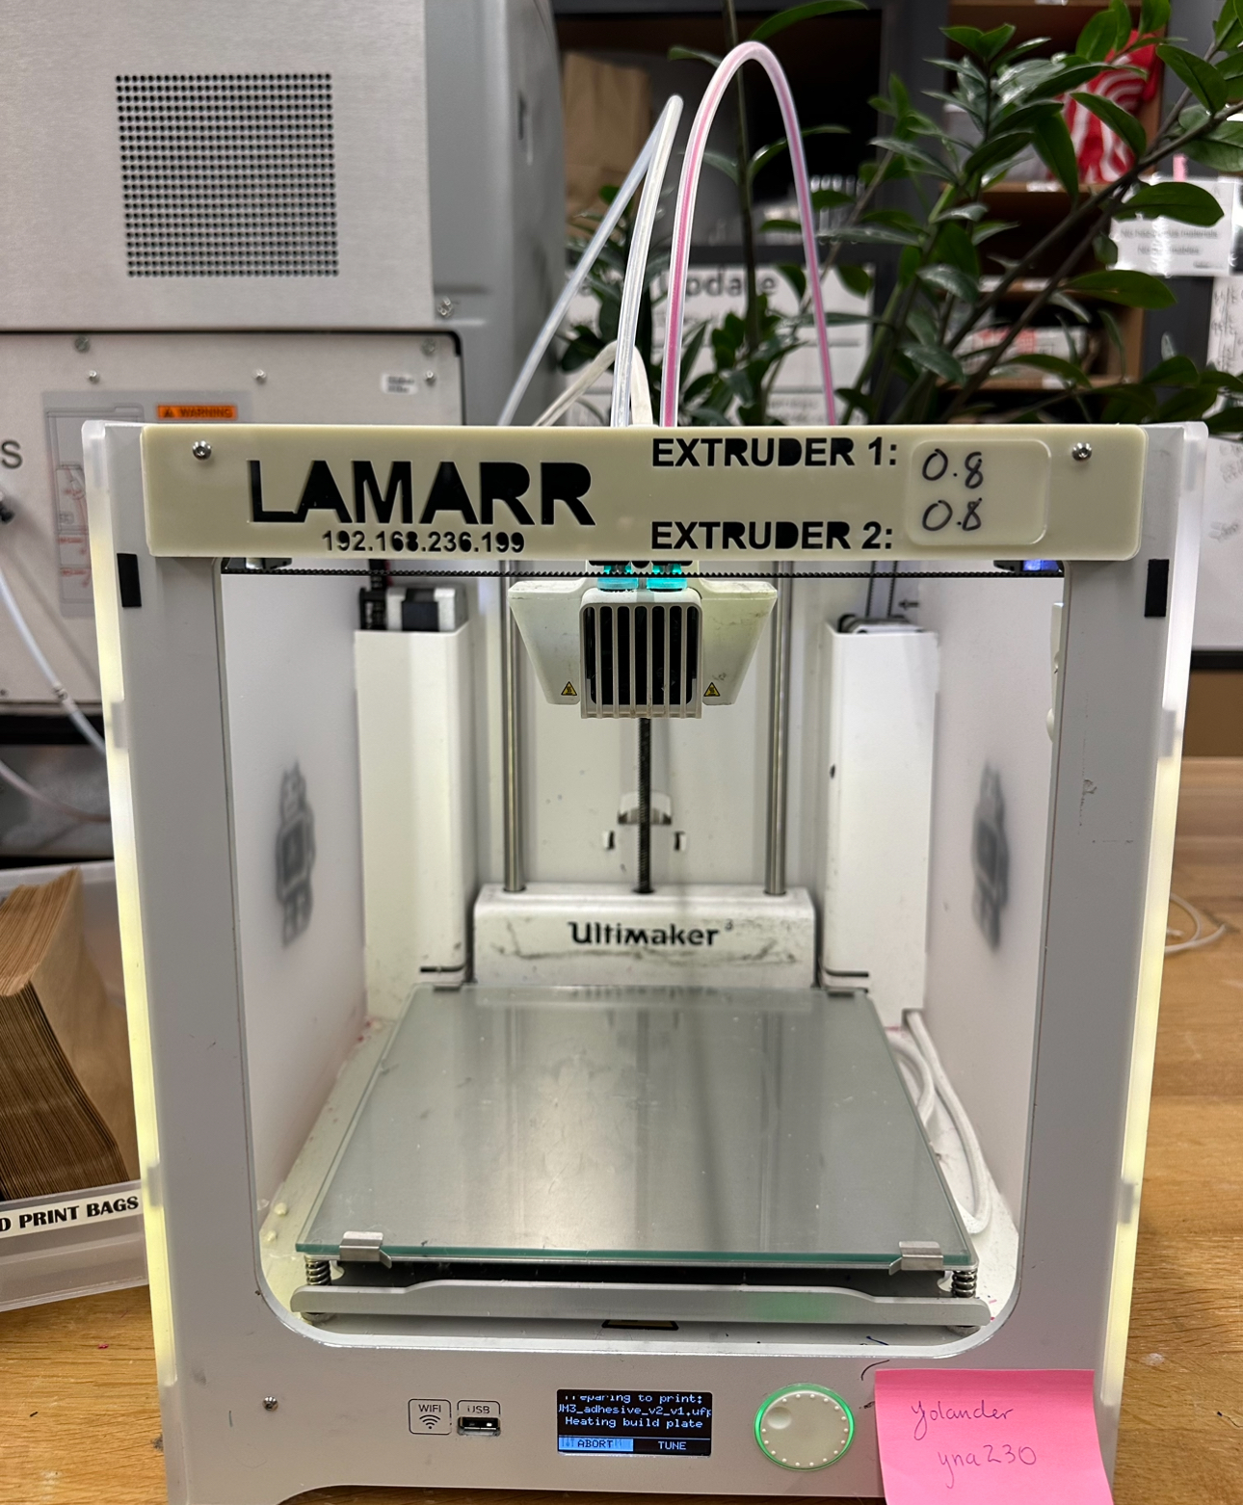
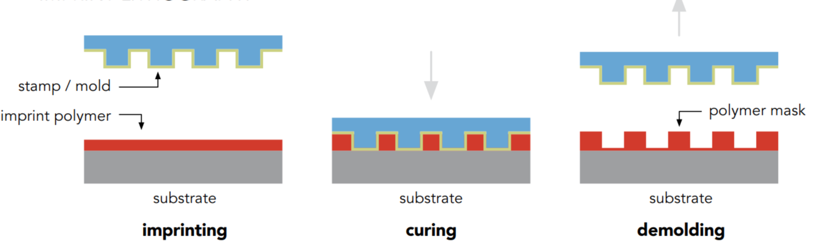
MANUFACTURING
CONVENTIONAL
UTILIZED
INJECTION MOLDING
AUTODESK FUSION 360 + ULTIMAKER 3D + ASSEMBLY
NANOIMPRINT LITHOGRAPHY
Notes:
SYSTEM CHASIS - TPE
INSULIN RESERVOIR - POLYPROPYLENE
INFUSION SET - TEFLON/POLYURETHANE FOR BOTH CANULA AND TUBING
DUE TO LIMITATIONS,
-PLA FOR ENTIRE SYSTEM, TPU FOR ADHESIVE

Slide 22

Future Considerations
Color-match device with user’s skin tone (increased concealability)
Complete elimination of invasiveness (precise insulin delivery without infusion cannula)
More biosensors for monitoring other parameters

Slide 23
ANY QUESTIONS?

